Slide 1
Building Basic Calculator
Name: NAVNEET KUMAR
20th Feb 2026
Organization Name: NextHikes IT Solutions

Slide 2
Introduction
Tkinter library is the Basic GUI toolkit
for Python.
GUI makes programs more interactive and user friendly.
Moving from console -> GUI improves usability and presentation.

Slide 3
Problem Statement
Console-based calculator limitations
Text-only interface
Less intuitive for beginner
Harder to reuse in real-world applications

Slide 4
Objectives
Create
Create a simple calculator with GUI
Use
Use Tkinter widgets (buttons, labels, entry fields)
Improve
Improve usability and presentation

Slide 5
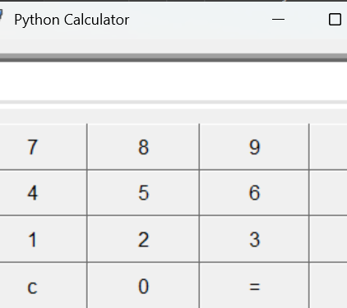
Program Structure
Import Tkinter
Create main window(Tk ())
Add widgets
(buttons, entry fields)
Define functions for
operations (+, -, ×, ÷)
Run event loop (mainloop())

Slide 6
Advantages of GUI Calculator
Easy to use
Clear presentation
Reusable for future projects
Foundation for advanced applications

Slide 7
Conclusion
Thinter makes Python programs interactive
GUI enhances usability and presentation
Next steps: add more operations, error handling, styling

Slide 8
THANK YOU

